Slide 1

Video Game Rental Management System
By Isaac Olubiyi - Project Overview Presentation
B8IT150 ADVANCED PROGRAMMING (B8IT150_2425_TME4)

Slide 2
1. Background / Introduction
A console-based .NET application for managing video game rentals.
Tracks inventory, checkouts, returns, and analytics.
Includes admin authentication and SQLite persistence.

Slide 3
2. Target Users / Beneficiaries
Rental store administrators.
Small game shops needing low-cost inventory software.
Students learning .NET + SQL with a real case study.
Anyone managing check-in/check-out stock workflows.

Slide 4
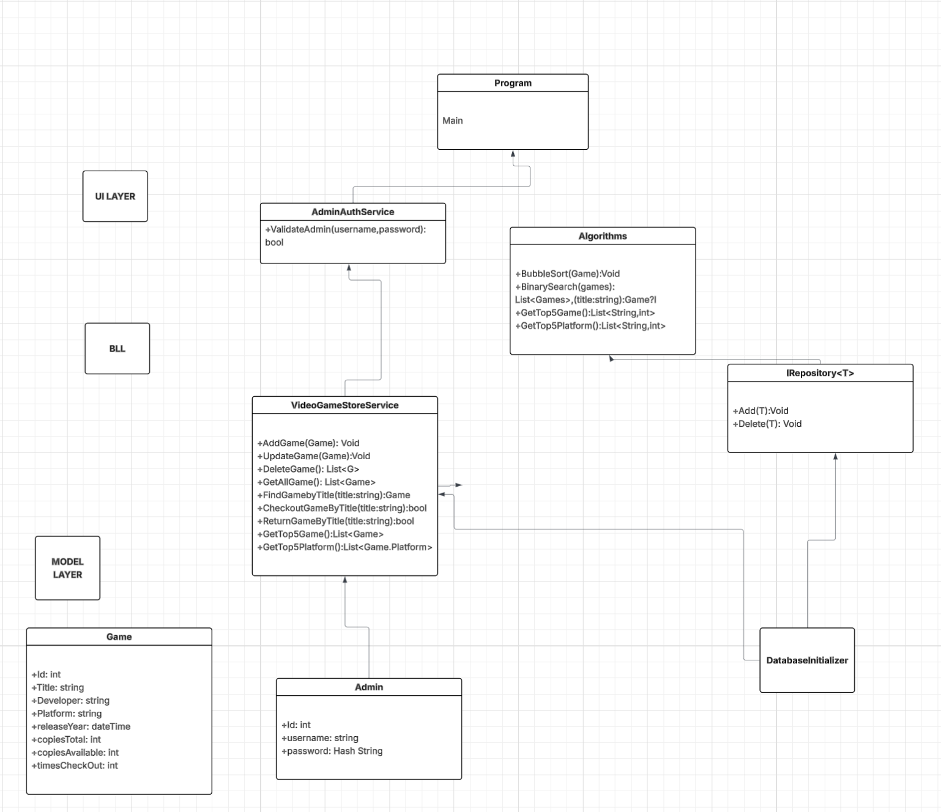
3. System Design Diagram

Slide 5
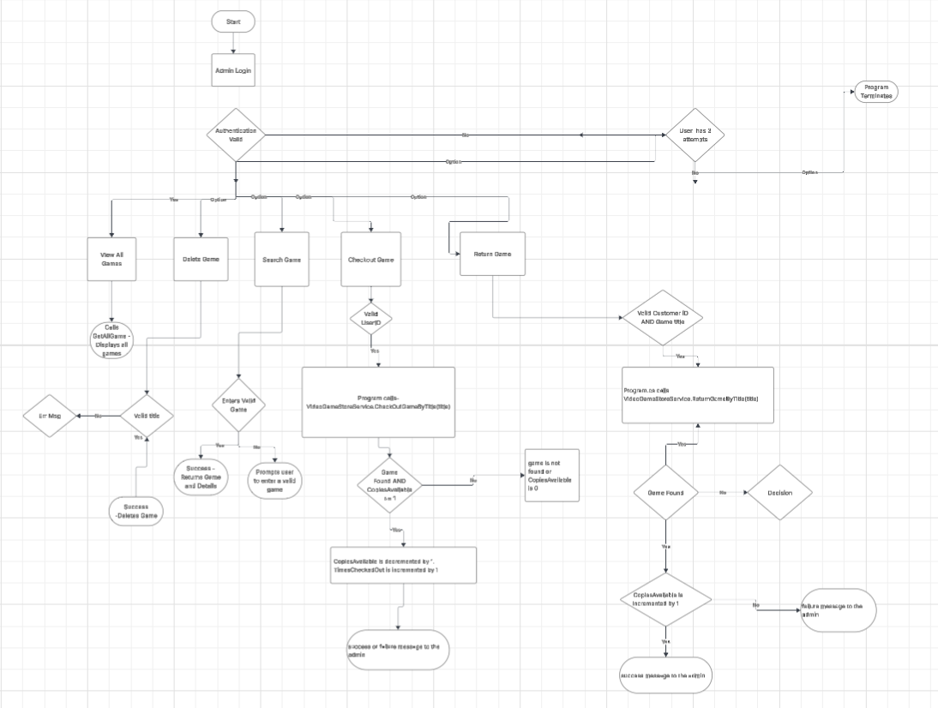
4.System Design Workflow

Slide 6
5. Technologies Used
.NET 8 (C#)
SQLite Database
Dapper ORM
Layered Architecture (UI, BLL, DAL)
Custom Algorithms (Sorting, Searching, Analytics)

Slide 7
6. Project Features
Add / Update / Delete games
Search by title
Bubble Sort + Binary Search
Check-out and return games (with customer ID)
Admin authentication via SQLite
Analytics: Top 5 games and top 5 platforms

Slide 8
7. Future Work
• Add GUI (WinForms or WPF)
• Add customer database + rental history
• Add overdue tracking + fines
• Export analytics to PDF/Excel
• Cloud-based database

